Slide 1
EART 28202 : Structural Geology
Class 7 : Faulting
Notes:
In the notes panes to these slides there are numerous references (figure credits and further reading). If the reference is incomplete it refers to the references stated in the reading list on the last slide
With regard to figures in this PowerPoint file, many will be subject to copyright restrictions. I don’t care about you using any of the figures/photos that are mine (Steve Covey-Crump), although a credit would be nice, but take care to comply with copyright restrictions if you reuse any that are not

Slide 2
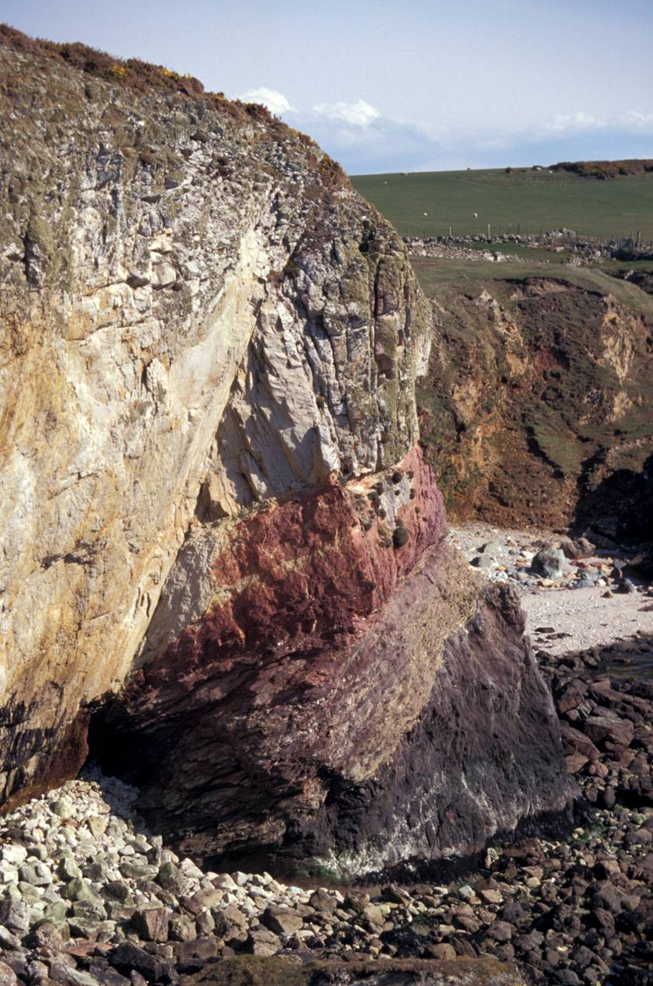
Faults
A fault is a surface or narrow zone along which there is measurable (at the exposure scale) surface-parallel displacement
This definition is identical to that of a shear fracture except for the scale of the displacement
Although described as a surface, faults have thickness (they are zones of deformation)
A fault may therefore be considered as a tabular volume of rock comprising a central core formed by intense shearing, together with a surrounding volume of rock (damage zone) that has been less intensely affected by brittle deformation
Notes:
On Slide 28 there is a diagram of what I mean by a tabular volume of rock with a central core and a surrounding damage zone
Photo (Steve Covey-Crump): fault at Porth Saint, near Rhoscolyn, Holy Island, Anglesey. Note that although the fault appears as a sharp surface, the rocks either side of this surface are heavily fractured

Slide 3
Fault geometry

Slide 4
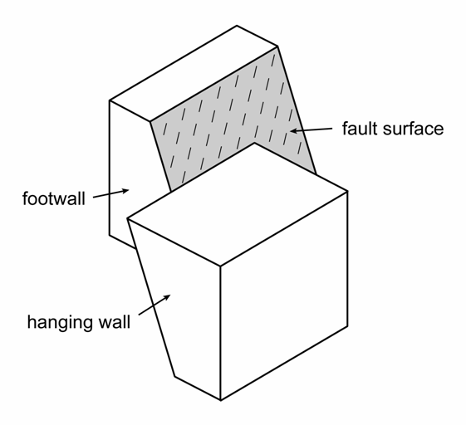
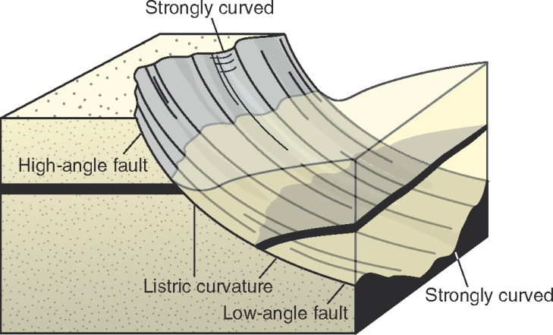
Fault surface dip
A fault divides the rocks that it cuts into two blocks. For faults that are not vertical, the block below the fault is the footwall and the block above the fault is the hanging wall. For vertical faults the sides of the fault are named by their geographical location, e.g., west side
Faults are described by their dip: low-angle faults dip less than ~30°; high-angle faults dip more than ~60°
Listric faults flatten downwards (common); anti-listric faults steepen downwards (unusual)
For faults with a staircase geometry in cross section, the parts that are at a relatively high angle to the layering are ramps and the parts that are sub-parallel to the layering are flats. We will refine the ramp-flat terminology in Classes 8-10
Notes:
For vertical faults there isn’t a side that is below the fault and a side that is above it, that is, there is no footwall and hanging wall. Hence, in this case we have to refer to west side, east side, etc.
Listric and anti-listric faults are curved faults
Figure top right by Steve Covey-Crump
Figure bottom left from Fossen, p.179

Slide 5
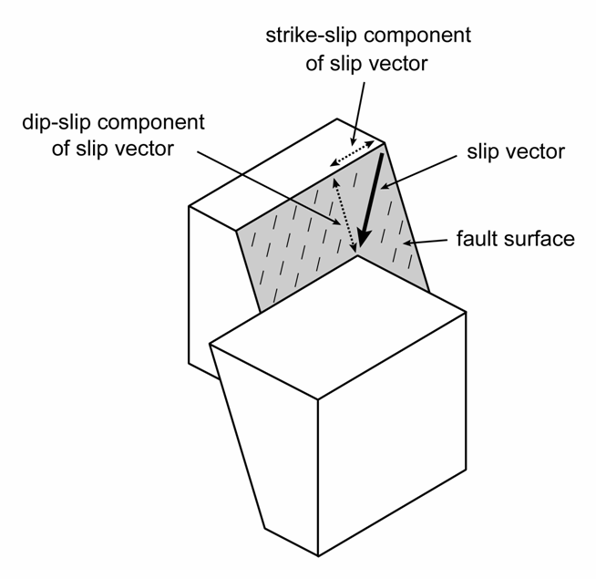
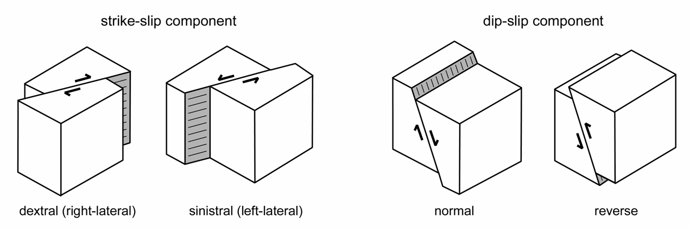
Slip vector
The vector connecting the location of a point on the fault plane before and after faulting is the slip vector
The slip vector may be separated into:
  strike-slip component (parallel to the strike of the fault) and which has dextral or sinistral sense
  dip-slip component (parallel to the true dip of the fault) and which has normal or reverse sense
Hence, we have pure dip-slip, pure strike-slip, or more generally, oblique-slip faults
If the slip vector changes orientation along strike, the fault is described as a rotational fault
Notes:
Remember that to define the sense of strike-slip displacement, stand on one side of the fault (it doesn’t matter which) and see which direction the other side has moved: if it is to the left it is sinistral and if it is to the right it is dextral. Sinistral and dextral derive from the Latin, ‘sinister’ and ‘dexter’ – the Romans were suspicious of left-handed people
Remember that to define the sense of dip-slip displacement, look at the direction that the hanging wall has moved: if it has moved down the fault plane it is normal and if it has moved up the fault plane it is reverse. This terminology comes from the Welsh coal miners – they mostly encountered normal faults
The figure top right which defines the slip vector shows a dextral-normal oblique-slip fault
Figures by Steve Covey-Crump

Slide 6
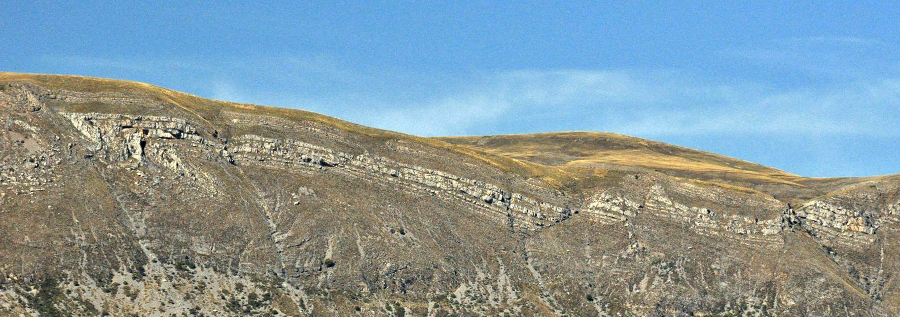
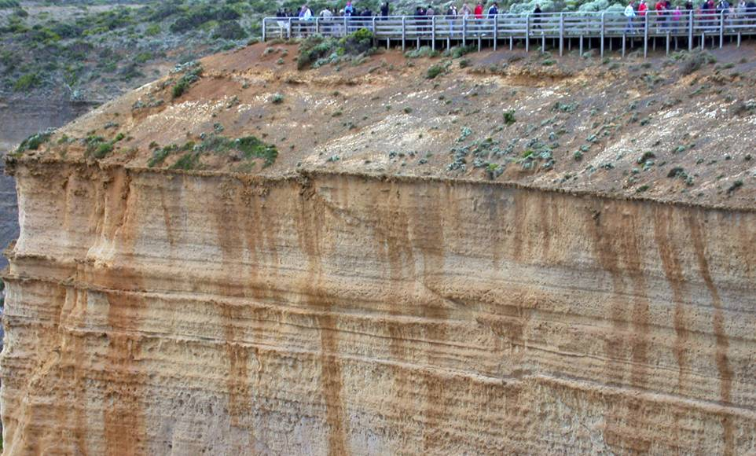
Some examples
Low angle normal faults, slightly listric
Low angle reverse fault (thrust)
Notes:
Photo top (Steve Covey-Crump): view to the north from the Panorama du Vélodrome, near Digne-les-Bains, SE France
Photo bottom (Steve Covey-Crump): cliffs at The Twelve Apostles, Victoria, Australia

Slide 7
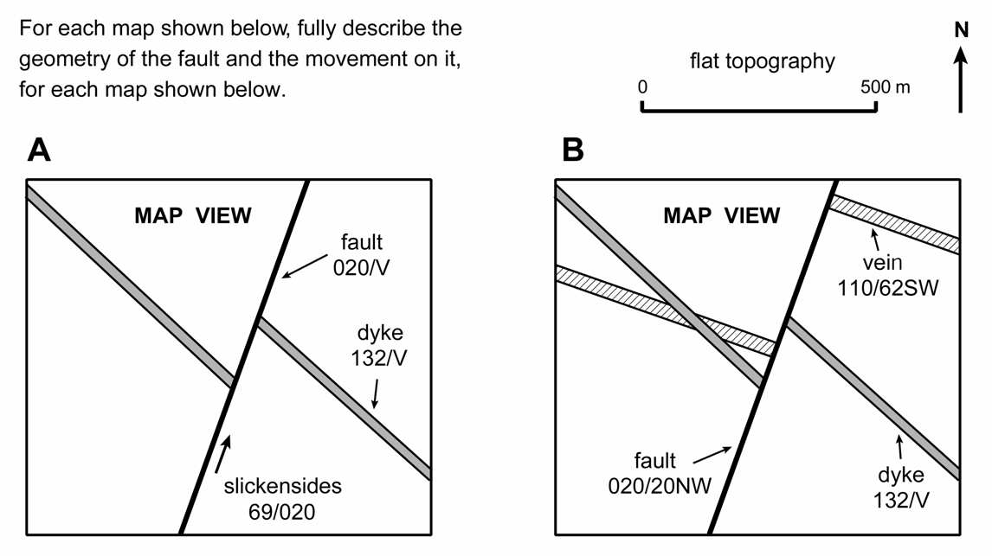
The orientation and magnitude of the slip vector
The orientation and magnitude of the slip vector may be determined if we have
  the strike/dip of the fault
  and either
  the direction of slip on the fault plane (typically from slickensides) and one apparent offset of a surface with known strike/dip
  or
  two apparent offsets of surfaces with known (and different) strike/dips
The orientation and magnitude of the slip vector may be found by constructing a fault plane section with the aid of a stereogram (as we did in Practical 4)
In areas with topography, the fault plane section may be constructed using stratum contours
Notes:
Figure by Steve Covey-Crump

Slide 8
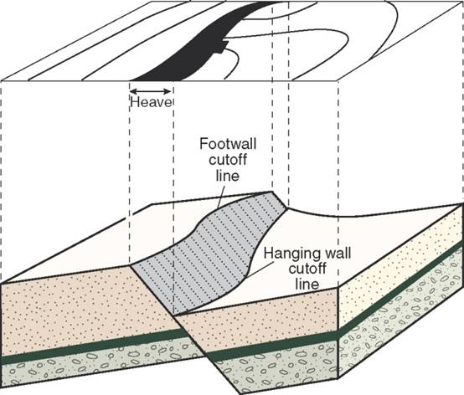
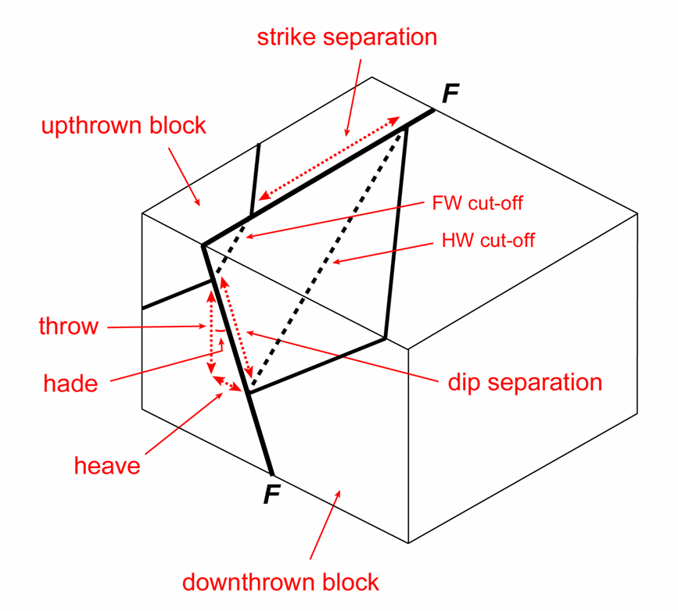
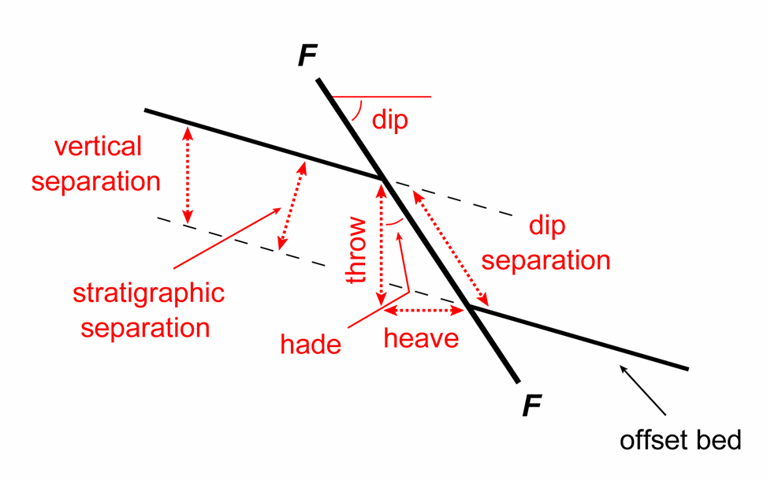
Separation of layers
When we have the strike/dip of the fault and the offset of only one planar feature (e.g., a lithological contact), the term separation is used
Evaluating separation terms commonly utilizes cut-off lines = the intersection of a surface of interest with the fault plane. There are two of these – one for the footwall and one for the hanging wall
Strike separation is the apparent offset parallel to the strike of the fault; all other separation terms are defined in the vertical plane that contains the dip direction of the fault
Notes:
When you are mapping faults, it is commonly the case that you have some knowledge of the strike/dip of the fault (perhaps obtainable using stratum contours), and you have the apparent offset of some contact of known dip. In this situation you do not have enough information to determine the slip vector, but you can evaluate the separation terms using trigonometry. This strategy is widely employed within the petroleum and mining industries so that something quantitative can be said about the magnitude of slip
The spacing between the footwall and hanging wall cut-off lines when plotted on a map is the heave (see figure top right)
Figures left and bottom right by Steve Covey-Crump
Figure top right from Fossen, p.182

Slide 9
Structures indicating slip vector movement sense and orientation

Slide 10
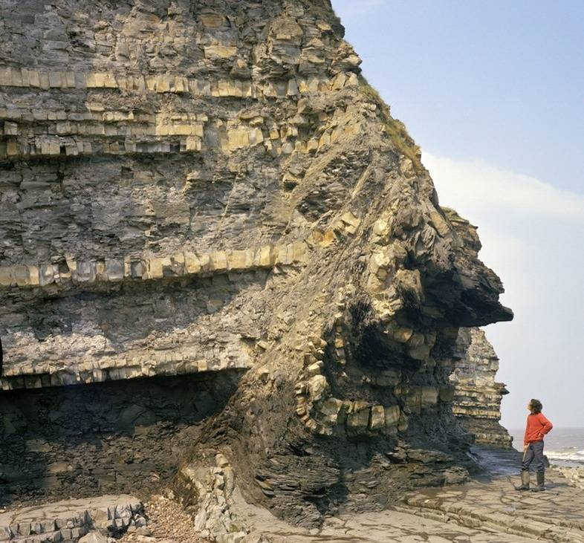
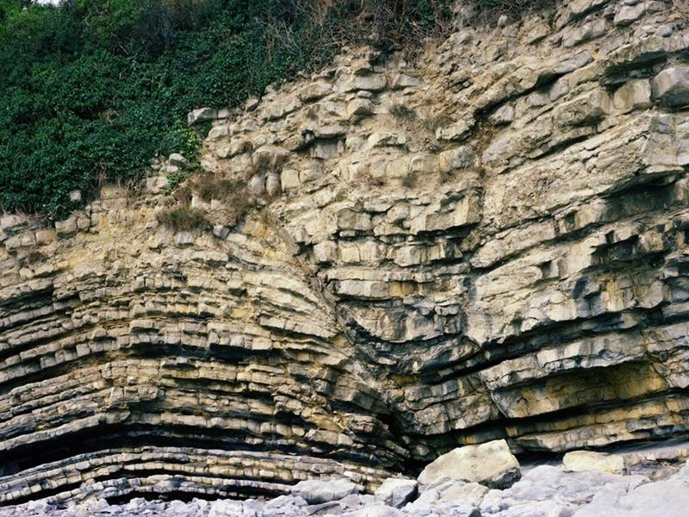
Folded surfaces near faults
The layering cut by faults often bends in a way that allows the movement sense to be determined. These structures are described as drag folds
Drag folds form most easily when the cut-off lines are at a high angle to the slip vector, and so in sub-horizontal sedimentary rocks they are most commonly seen on high angle normal and reverse faults
Notes:
Photo left (from the BGS image database: geoscenic.bgs.ac.uk/asset-bank/action/viewHome, image P211325): drag folds in the footwall of a reverse fault, Blue Lias (Jurassic) units at Blue Ben, Watchet, Somerset. This fault is actually a reactivated normal fault, that is, initially it was a normal fault (evidence not apparent in the photo) formed during extension but during subsequent shortening the sense of movement was reversed. For comments on this fault, see Peacock, 2009, Italian Journal of Geosciences 128: 307-316, https://doi.org/10.3301/IJG.2009.128.2.307
Photo right (from the BGS image database: geoscenic.bgs.ac.uk/asset-bank/action/viewHome, image P212144): drag folds on a normal fault, Lower Lias (Jurassic) sandstones and mudstones in the cliffs east of Dams Bay, Rhoose, near Barry, South Wales

Slide 11
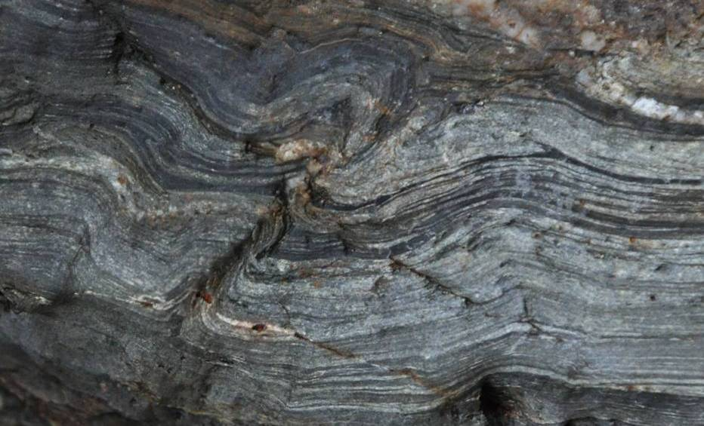
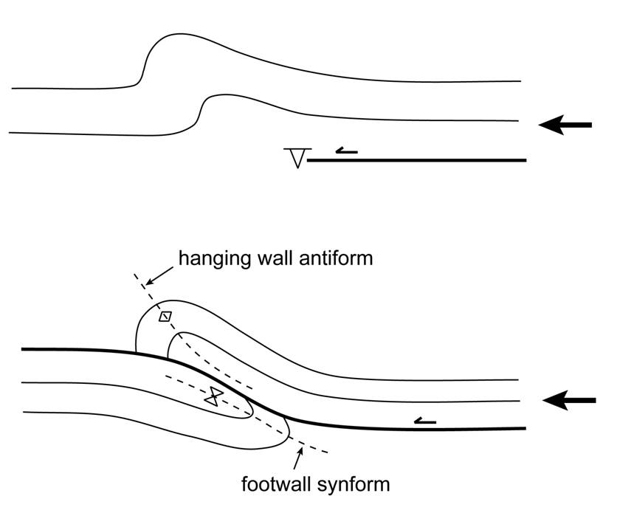
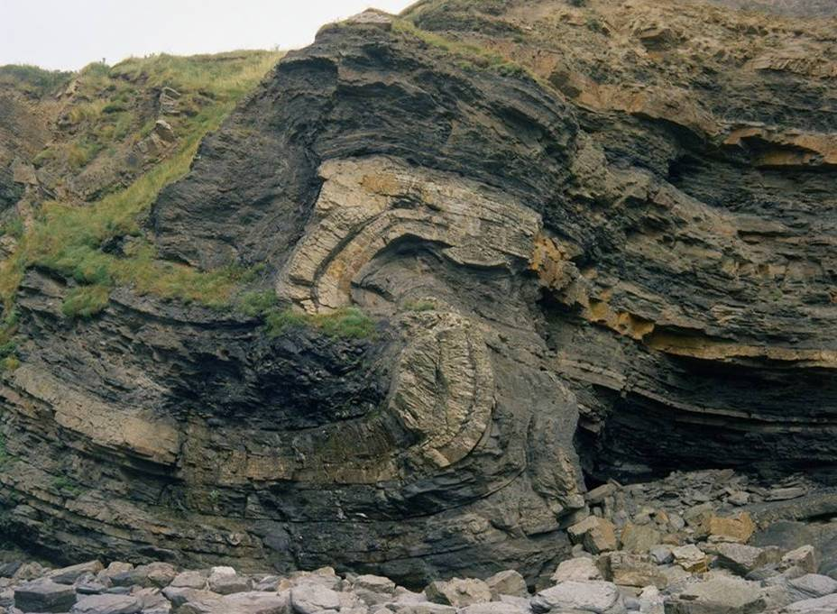
Folded surfaces near faults: fault propagation folds
Many drag folds result from bending of layers ahead of propagating fault tips – folding precedes the passage of the fault; they are breached fault propagation folds
A hanging wall antiform – footwall synform pair may be formed when a thrust fault breaches the fault propagation fold
Notes:
Figure left by Steve Covey-Crump
Photo top right (Steve Covey-Crump): small-scale unbreached antiform-synform pair, south side of Crantock Beach, north Cornwall (image is ~6 cm across). Note the attenuated middle limb near where I have placed the lazy arrow
Photo bottom right (from the BGS image database: geoscenic.bgs.ac.uk/asset-bank/action/viewHome, image P211445): hanging wall antiform – footwall synform pair on a thrust fault in interbedded Carboniferous sandstones and mudstones, near Broadhaven, St. Brides Bay, Pembrokeshire. This fold, which may be considered as a breached fault propagation fold, is analysed in Williams & Chapman, 1983, Journal of Structural Geology 5: 563-571, https://doi.org/10.1016/0191-8141(83)90068-8
We will return to the relationship between folding and thrusting in the next class on contractional tectonic regimes (Class 8)

Slide 12
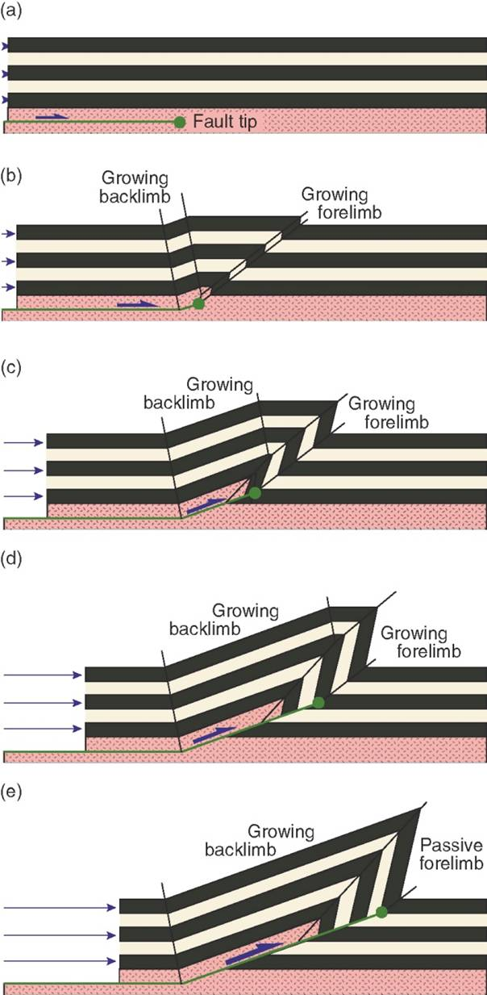
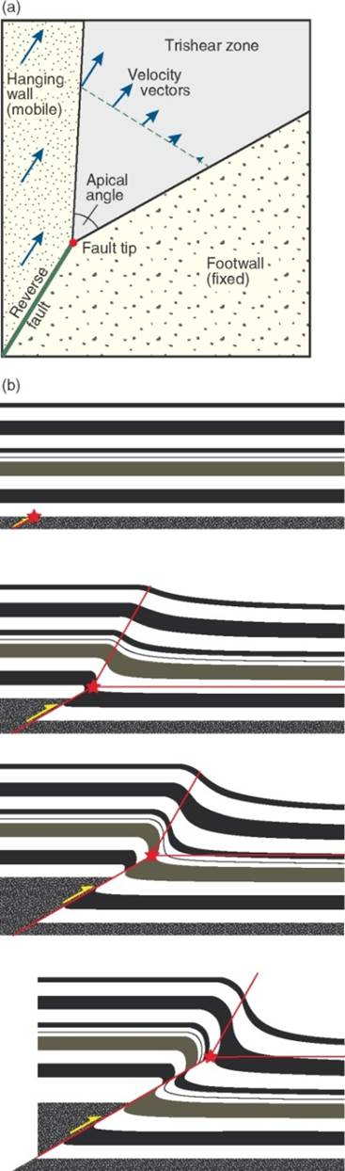
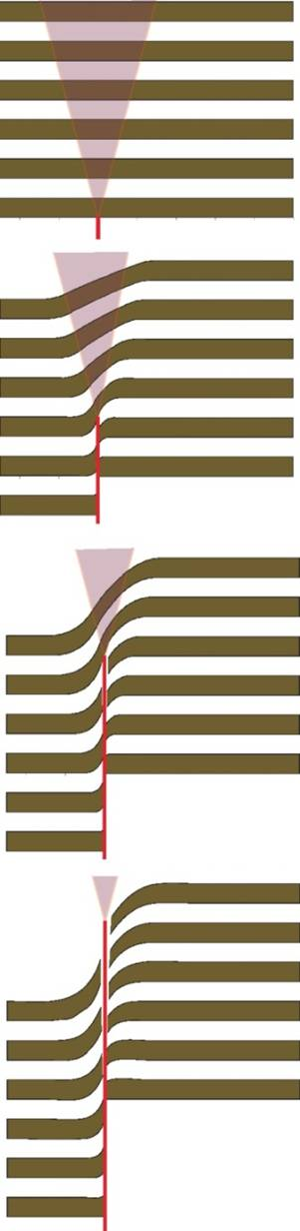
Modelling the geometry of fault propagation folds
Growth of parallel kink-like folds: loss of slip ahead of the fault-tip is accommodated by growth of the crest of the fold
Trishear approach: loss of slip ahead of the fault-tip is accommodated in a triangular zone of shear planes that radiate from the fault tip
Notes:
Attempts to model the formation and geometry of fault propagation folds mostly fall into the two categories that are illustrated on this slide. For an overview, see Hughes & Shaw, 2015, Geological Society of America Bulletin 127: 1752-1765, https://doi.org/10.1130/B31215.1. There are also helpful descriptions given in Rick Allmendinger’s Structural Geology Lab Manual, p.213-218 (available at https://www.rickallmendinger.net/)
For an account of how fault-propagation folding may be modelled using the kink-like fold approach, see Suppe & Medwedeff, 1990, Eclogae Geologicae Helvetiae 83: 409-454, https://www.e-periodica.ch/digbib/view?pid=egh-001%3A1990%3A83%3A%3A230#418
For a summary of the development and use of the trishear model, see Hardy & Allmendinger, 2011, American Association of Petroleum Geologists Memoir 94: 95-119, https://doi.org/10.1306/13251334M943429
In the trishear model strain is distributed in a triangular zone ahead of the fault tip. The hanging wall side of the triangle moves at constant velocity above a fixed footwall, the triangular zone is symmetrical with respect to the fault, and the velocity vector is the same for all points located along any ray originating from the fault tip. Hence across the triangle zone the velocity increases towards the hanging wall and the velocity vector gradually changes orientation accordingly (see top diagram of middle figure on the slide). This generates the folding. The triangular zone moves through the layers as the fault tip propagates and no further folding occurs once the fault has cut through it. The precise geometry of the folding depends upon the choice of the apical angle, the fault dip and magnitude of slip, and the ratio of how fast the fault tip propagates relative to the slip on the fault. Trial and error is used to vary these parameters until the results match the geometry obtained from field observations. For downloadable software that implements trishear modelling, see program FaultFold on Rick Allmendinger’s site (https://www.rickallmendinger.net/)
Figure left from Fossen, p.366
Figure middle (from Fossen, p.200) showing the parameters used in trishear modelling and an example of its implementation for folds developed ahead of the tip of a reverse fault
Figure right (from Fossen, p.199) showing trishear modelling of folds ahead of an upward propagating normal fault

Slide 13
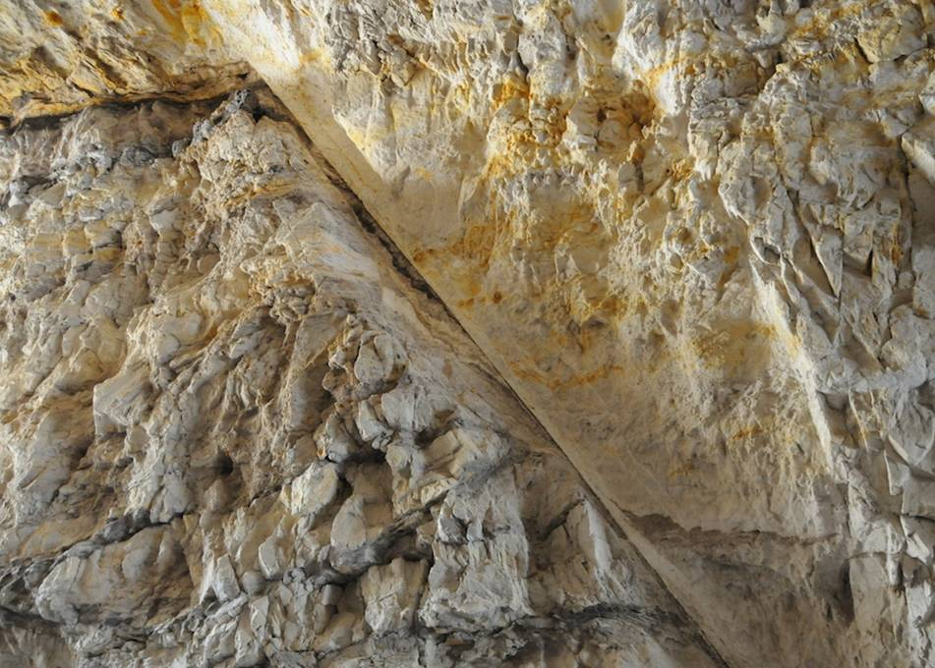
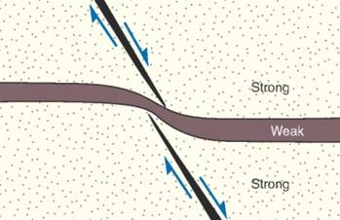
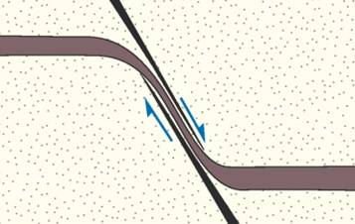
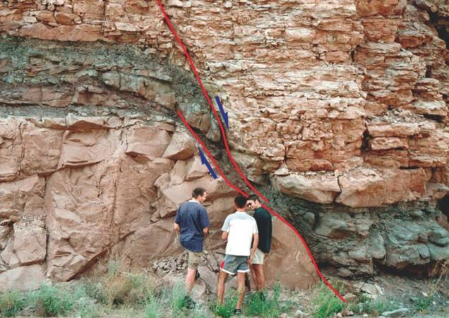
Folded surfaces near faults: clay smears
While many drag folds are breached (faulted) fault propagation folds, drag folding can also develop in the zone of interaction between two overlapping en échelon faults
In this case, if the folded layer is weak (mudstone) then it may be taken to the point of forming a smear along the fault
Clay smear
Notes:
Fault overlap leads to a wide range of structures that are noted in the discussion of transfer zones below (Slides 42-43). Clay smears are important because they can seal the faults within a fluid reservoir (see Fossen, p.213-214). For a comprehensive review of the formation of clay smears and their influence on fluid flow, see Vrolijk et al., 2016, Journal of Structural Geology 86: 95-152, https://doi.org/10.1016/j.jsg.2015.09.006
Photo left (Fossen, one of the extra figures on the web-site for the book, folk.uib.no/nglhe/StructuralGeoBook.html; see Fossen, p.213): clay smear developed on a normal fault within interbedded fluvial sandstone and mudstone units, Castlegate Formation, Salina, Utah. In this case a centimetre-thick clay smear along the fault separates porous sandstone units that are of reservoir quality
Photo right (from Fossen, p.209): clay smear formed where a muddier layer has been caught between two overlapping faults (Moab, Utah)
Figures top right are from Fossen, p.201

Slide 14
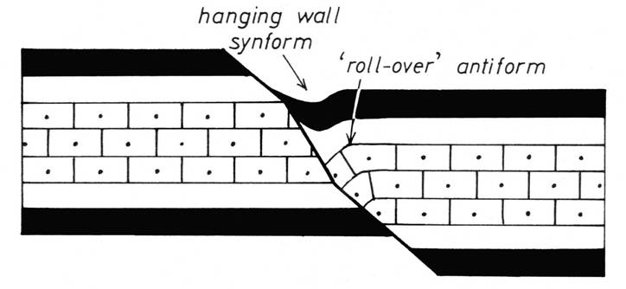
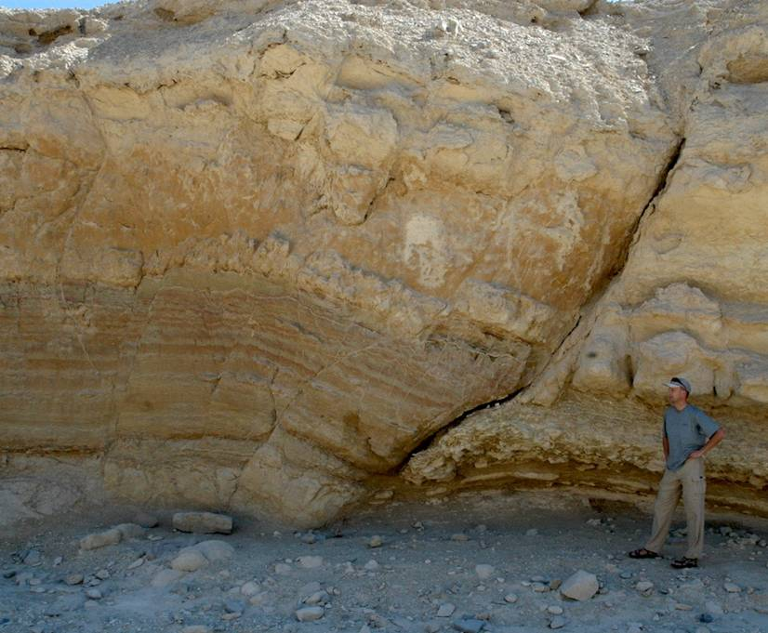
Folded surfaces near faults: rollover antiforms
Alternatively, folding may occur where faults change orientation along their length – either in map view (change in fault strike) or in section (change in fault dip)
Changes in fault dip require internal deformation within the hanging wall to avoid space problems – in normal faults if the fault steepens downwards a hanging wall synform is required whereas if it shallows a hanging wall antiform is needed
On a listric normal fault the downwardly decreasing dip commonly leads to a roll-over antiform within the hanging wall
Note that in this case the direction of bending is opposite to that in drag folds and so this is sometimes described as reverse drag
Notes:
Fault bends (changes in fault strike) are considered below (Slide 44) and will be revisited in more detail in the lecture on strike-slip tectonic regimes (Class 10). We will also look in more detail at roll-over antiforms and the structures associated with normal faults in the lecture on extensional tectonic regimes (Class 9)
Figure left from Ramsay & Huber, p.518
Figure right (Fossen, one of the extra figures on the web-site for the book, folk.uib.no/nglhe/StructuralGeoBook.html; see Fossen, p.197): a rollover antiform developed over a bend in a normal fault, Matulla Formation, Wadi Matulla, Sinai

Slide 15
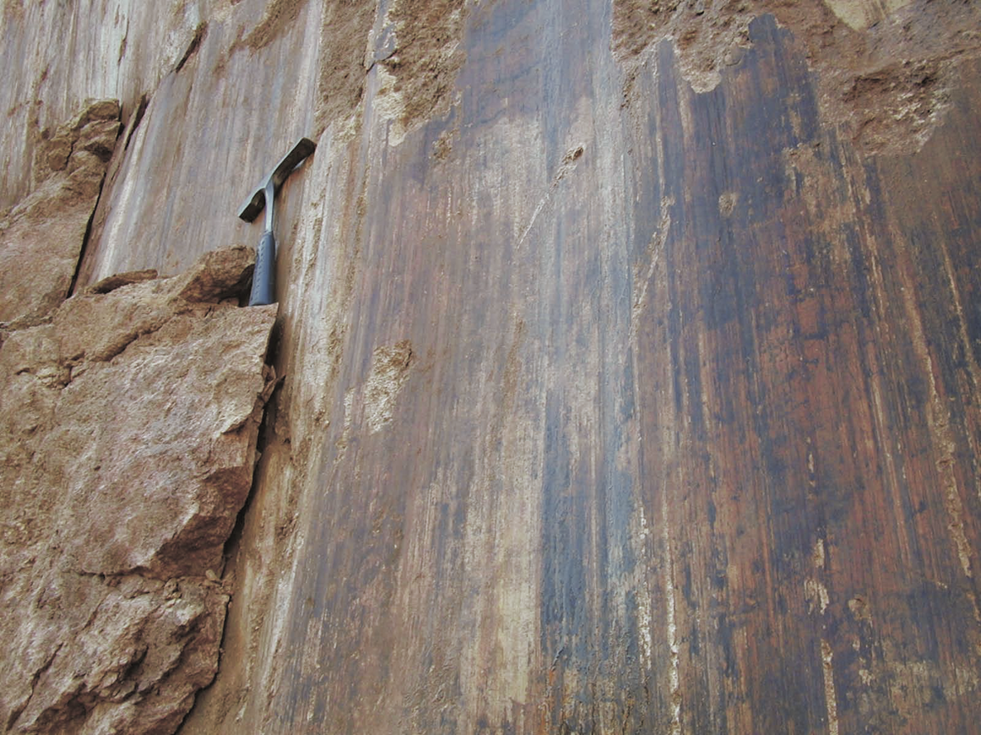
Slickensides
In response to movement, fault surfaces commonly become smooth and polished and are then described as slickensides (sensu stricto)
Fault surfaces (including slickensides), particularly where they are not perfectly planar, commonly develop three types of strongly oriented lineations, that are also described as slickensides (sensu lato)
Ridges and grooves formed by gouging of the fault surface and by accumulation of debris behind asperities
Slickenfibres formed by growth of minerals parallel to fault slip vector during slow shearing
Mineral streaks formed from pulverized and streaked out mineral debris
Notes:
Note that “slickensides” is not always used in accordance with its precise definition. Strictly, “slickensides” refers to the polished surface. However, it is often used in a more general sense to refer to the lineations (variously described as slickenlines, slickenside lineations, striations, slickenfibres) on a fault surface
Highly polished (mirror-like) fault surfaces are commonly observed on faults formed at shallow crustal depths. In carbonate-rich lithologies they arise from decomposition (chemical breakdown) of the carbonates during seismic ruptures – the solid reaction products of the decomposition (for dolomite = MgO + Mg-calcite) are nanometric-size particles that form thin (10-100 µm) layers on the fault surface. As such, they are indicators of fast (seismic) slip-rates (see Slide 30). For further discussion, see Fondriest et al., 2013, Geology 41: 1175-1178, https://doi.org/10.1130/G34641.1
Photo (from a PowerPoint presentation by Richard Lisle): a highly polished and lineated fault surface, Comillas, northern Spain

Slide 16
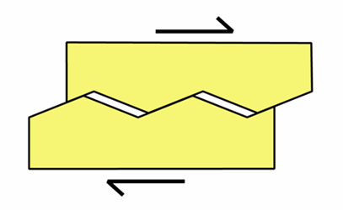
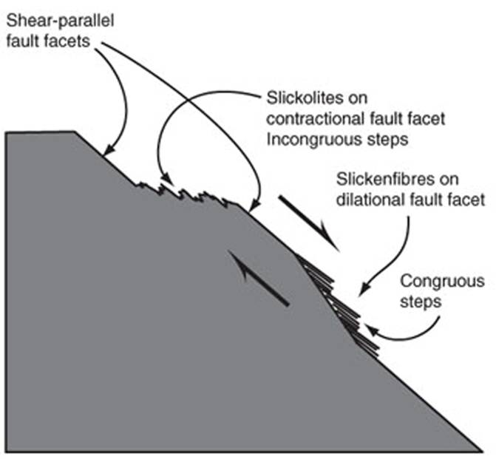
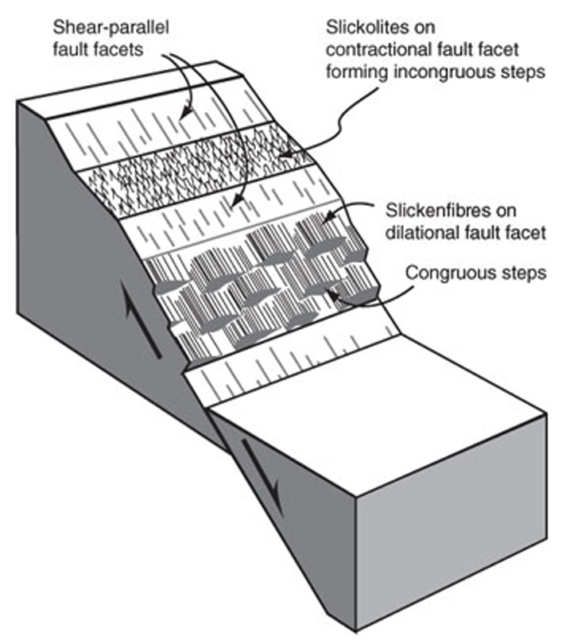
Slickensides 2
Shearing on non-planar surfaces leads to regions of compression and dilatancy
On surfaces under compression slickolites may develop, or there may be enhanced damage such as crushing and fracturing; on dilatant surfaces there may be mineral precipitation to form slickenfibres
With care such features may be used to indicate slip sense, the lineation itself providing the line of slip
Notes:
For a reminder of what slickolites are, see Class 6 Slide 10
In the figures on this and the following few slides, a step on a fault surface is described as incongruous if it faces against the movement of the overlying block, and as congruous if it faces in the direction of movement of the overlying block. Incongruous steps are therefore regions of compression (like a thrust ramp), and congruous steps are regions of dilatancy (like a low angle normal fault)
Figure left by Steve Covey-Crump
Figures middle and right from Twiss & Moores, p.73

Slide 17
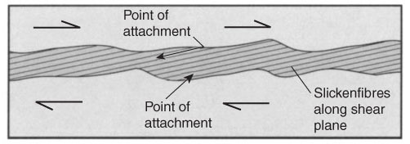
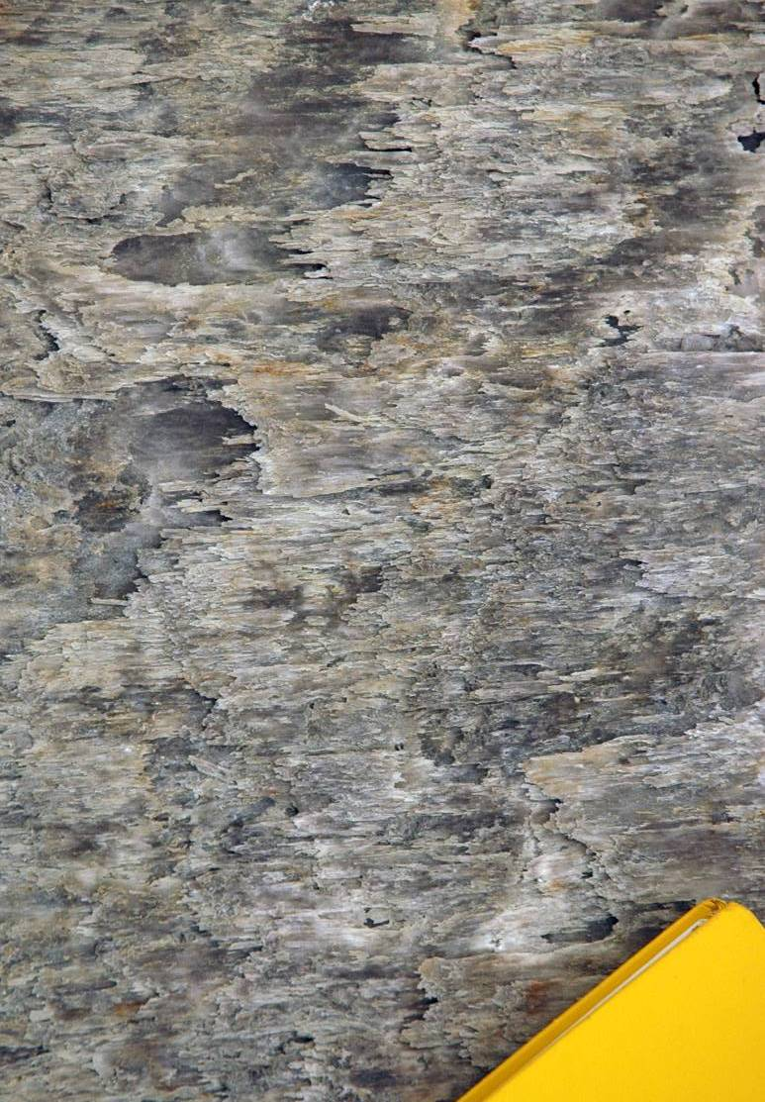
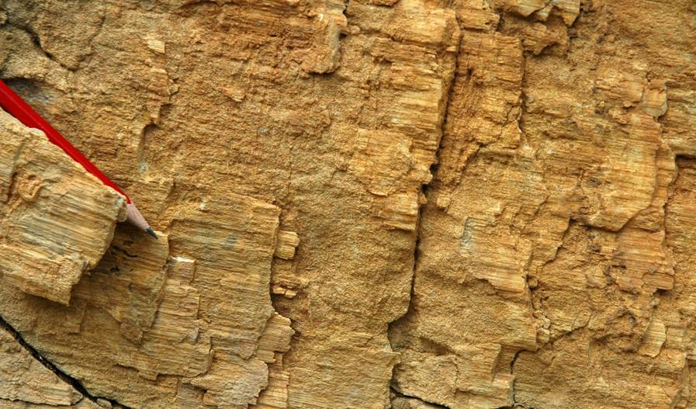
Slickenfibres
Slickenfibres form during slow aseismic slip (fibre growth is slow) as dilatant surfaces separate
They are exposed by the removal of part of one of the fault blocks – when the block is removed the fibres break to form steps
Your hand when rubbed on the surface in the smooth direction (down the steps) is moving in the direction of the missing block
dextral
sinistral
Notes:
To get the movement sense for the photo on the right: the smooth direction requires you to move your hand to the right and therefore the other side of the fault (the side we can see) has moved to the left (sinistral)
Figure top right is from Twiss & Moores, p.73
Photo left (Steve Covey-Crump): gypsum slickenfibres on the St. Lion’s Thrust, Barrême Basin, SE France
Photo right (Steve Covey-Crump): calcite slickenfibres in La Condamine Formation, near Barrême, SE France

Slide 18
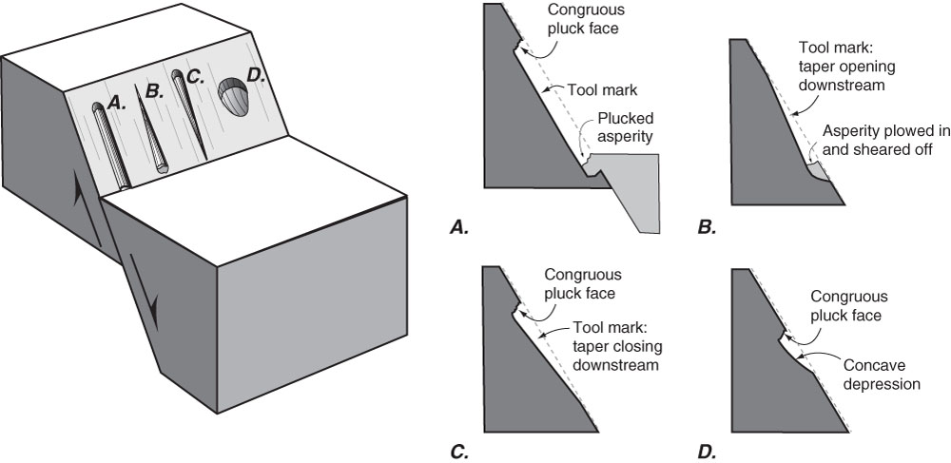
Ridges and grooves (gouging and plucking)
Tool marks created by asperities (hard mineral grains) and pluck holes may be used to support evaluations of slip sense, but they can be difficult to use on their own
Tool mark gouged out by an asperity in the opposite wall
Tool mark created by an asperity that is being ploughed deeper into the fault surface
Tool mark created by an asperity that is being progressively destroyed during shearing
Asymmetric pluck hole
Notes:
Figure from Twiss & Moores, p.75

Slide 19
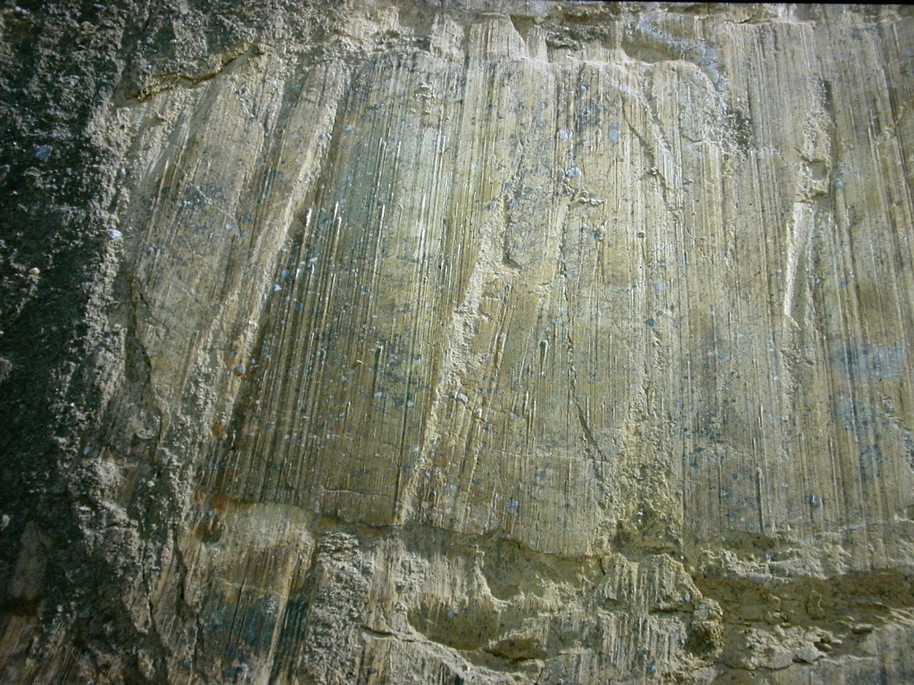
Ridges and grooves (gouging and plucking)
Ridges and grooves on the footwall of a high angle normal fault, Sierra Nevada, Betics (Spain)
Notes:
Although at the field observation scale nearly all fault surfaces contain ridges and grooves, at the sub-millimetre scale (typically less than 4-500 µm) the surface roughness of the fault plane becomes isotropic (ungrooved). This transition from grooved to ungrooved reflects the deformation of the asperities that generate the grooves – at large scales they behave as hard indenters, but at very small scales they yield plastically. For details, see Candela & Brodsky, 2016, Geology 44: 603-606, https://doi.org/10.1130/G37934.1
Photo (by José Miguel Martínez: www.ugr.es/~jmmm/Fotos_Eng.htm)

Slide 20
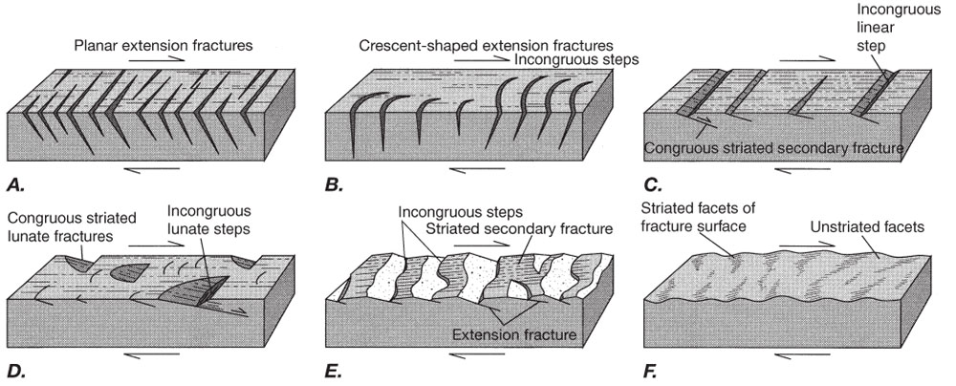
Secondary fractures
A wide range of extension and shear fractures develop during slip. These mostly cut into the fault surfaces with the same general obliquity as tension gashes, Riedel shears and pinnate fractures. If they are crescent-shaped their sense of curvature is the same as crescent-shaped aeolian ripples with the missing block moving in the “wind direction”
The reference to tension gashes, Riedel shears and pinnate fractures highlights the fact that many of the shear sense indicators discussed in previous classes can also be used to help establish slip sense
Notes:
For a reminder about tension gashes, see Class 4 Slides 33-36; for pinnate fractures, see Class 6 Slide 12; for Riedel shears, see Class 4 Slide 45
There are many other sense of shear indicators, although all the significant ones have been described in these slides. For further information, see Doblas, 1998, Tectonophysics 295: 187-197, https://doi.org/10.1016/S0040-1951(98)00120-6
Figure from Twiss & Moores, p.74

Slide 21
Formation of faults

Slide 22
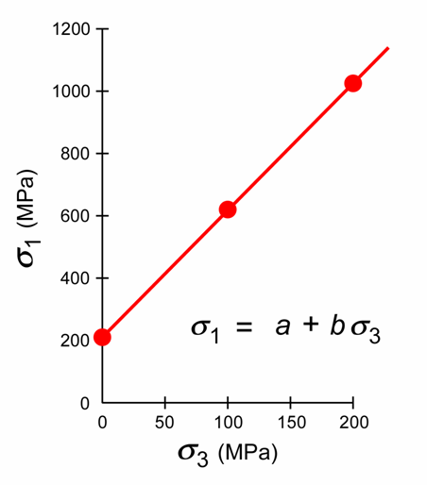
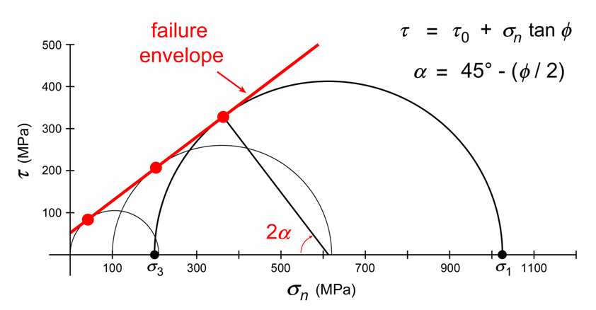
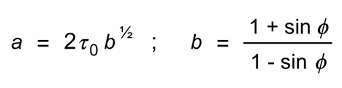
Failure criteria – intact rocks
In the brittle regime rocks become stronger with increasing confining pressure. We may show this graphically by plotting the maximum principal stress at failure against confining pressure (in axial compression experiments these are σ₁ and σ₃ respectively)
Alternatively, we may plot a Mohr diagram of the values of σ_{n} and τ on the fault plane at failure for each confining pressure – if the σ₁ vs. σ₃ plot is a straight line, so is the failure envelope on a Mohr diagram
intercept (τ₀) = cohesive strength ; slope (μ = tan ϕ ~ 0.6) = coefficient of internal friction
the angle (α) between the fault plane and σ₁ follows from the slope and is typically ~30°
φ
τ₀
Notes:
The figures show the stress at failure for experiments at three different confining pressures plotted as σ₁ vs. σ₃, and the same data plotted on a Mohr diagram. In the Mohr diagram the red dots show the stresses on the fault plane that formed when the sample failed; the red line is the failure envelope. Because the failure envelope is a straight line, the angle between the fault plane and σ₁ is the same in all three tests. [Note that when we described Mohr diagrams in Class 5 Slide 9, we specified the orientation of a plane by the angle (θ) between σ₁ and the normal to the plane, not the angle (α) between σ₁ and the plane. However, note that α = 90° - θ. I showed the Mohr circle construction using α instead of θ in Class 5 Slide 10
By looking at the Mohr diagram on this slide, it is apparent from the fact that the internal angles of a triangle add up to 180°, that for a linear failure envelope α = 45° - (ϕ/2). Since ϕ ~ 30° then α ~ 30°
The equation τ = τ₀ + σ_{n} tan ϕ, which describes a linear failure envelope, is known as the Coulomb failure criterion. Rocks actually tend to have slightly non-linear failure envelopes. When this is the case, the equation describing the failure envelope, written as τ = f(σ_{n}), is known as the Mohr-Coulomb failure criterion
Figures by Steve Covey-Crump

Slide 23
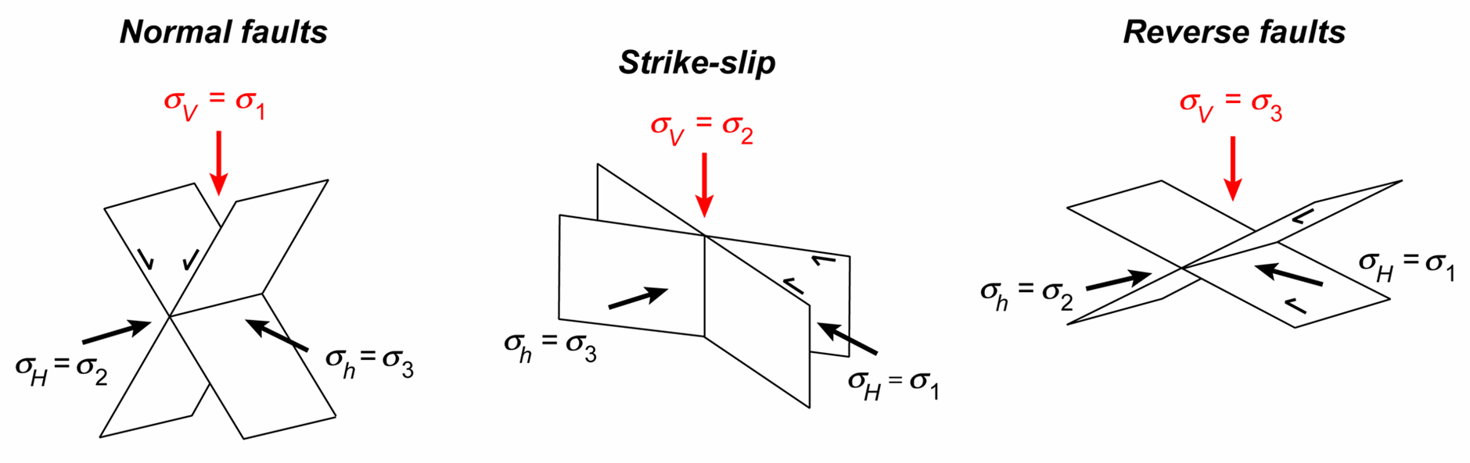
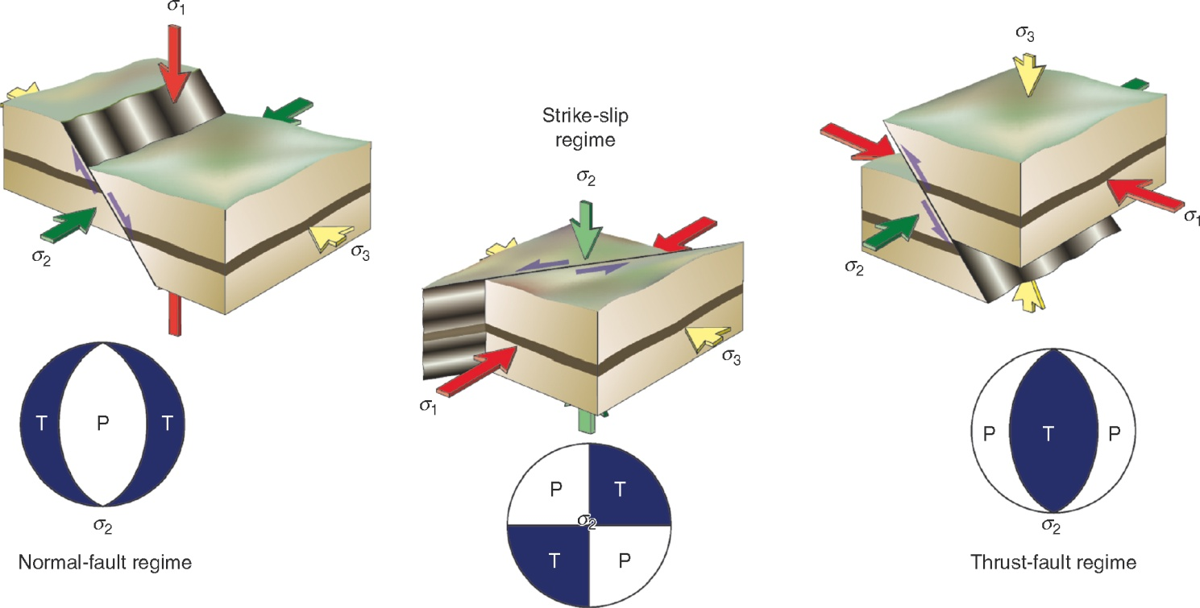
Andersonian classification of faults
If one of the principal stresses is vertical and α ~ 30°, then
  when σ₁ is vertical → we have normal faults dipping at ~60°
  when σ₂ is vertical → we have vertical strike-slip faults
  when σ₃ is vertical → we have reverse faults dipping at ~30°
Notes:
For the reasoning behind the approximation that one of the principal stresses is vertical, see Class 5 Slide 27
This slide describes the Andersonian classification of faults – see Anderson, 1905, Transactions of the Edinburgh Geological Society 8: 387-402, https://doi.org/10.1144/transed.8.3.387, and Anderson, 1951, The Dynamics of Faulting and Dyke Formation With Application to Britain (2nd edition). We briefly noted this classification in Class 5 Slide 32. The classification adopts the idealization that σ₂ lies in the plane of the fault, and hence leads to the notion that faults have a tendency to form conjugate pairs at ±30° to σ₁ (with σ₂ being parallel to the line of intersection of the two faults). This classification is extremely widely used. However, it is commonly found, both in nature and experiment, that three or more differently oriented faults are simultaneously active, not just two conjugate faults. In such cases σ₂ cannot be in the plane of the active faults unless they all share a common line of intersection. The significance of this reality, and the consequent limitations of the Andersonian fault classification scheme, are discussed by Healy et al., 2015, Journal of Structural Geology 80: 57-71, https://doi.org/10.1016/j.jsg.2015.08.013
Figure top by Steve Covey-Crump
Three figures bottom from Fossen, p.93

Slide 24
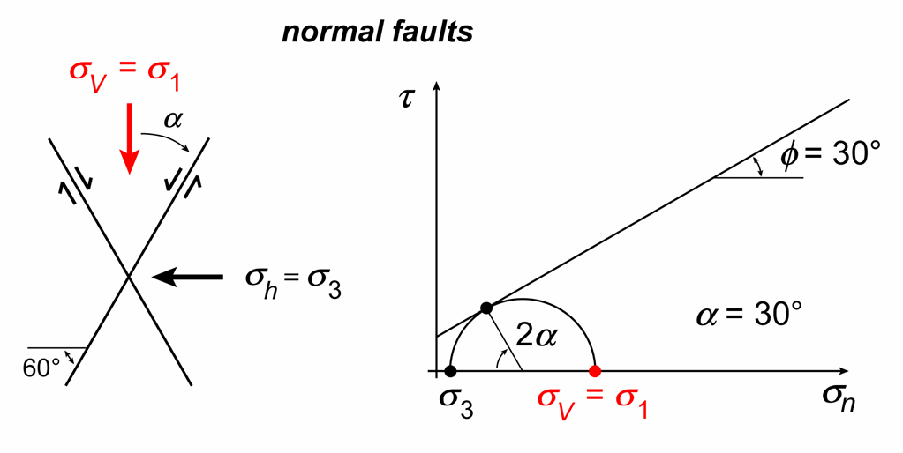
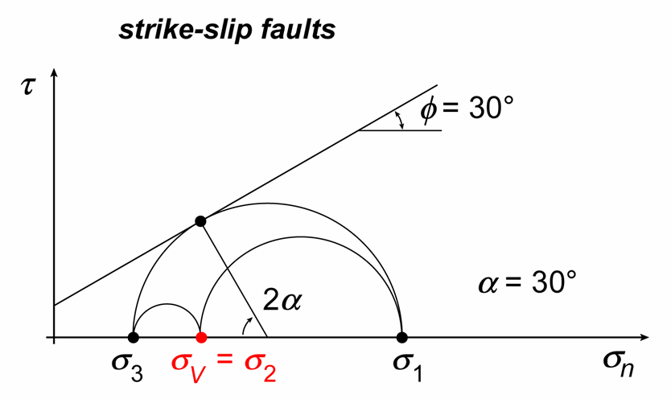
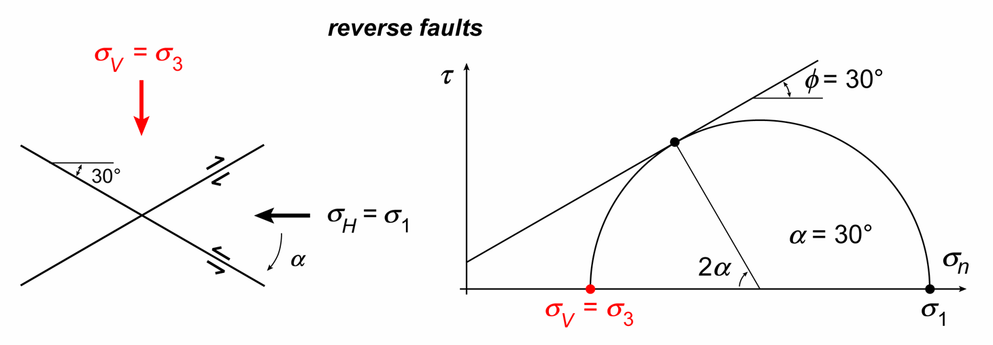
Andersonian classification of faults 2
Recall that σ_{v} = ρ_{rock}gz
σ₂ vertical
σ₁ vertical
σ₃ vertical
Notes:
These plots may be used to place limits (small and large) on the magnitude of the horizontal stress, e.g., if σ_{V} is a principal stress then the horizontal stresses cannot be smaller than σ₃ as shown on the normal fault Mohr diagram on this slide, or greater than σ₁ as shown in the reverse fault Mohr diagram on this slide. If you know whether you are in an extensional, strike-slip or contractional tectonic terrain then tighter limits on the horizontal stresses apply, e.g., in an extensional terrain the horizontal stresses cannot be greater than σ_{V}, while in a contractional terrain the horizontal stresses cannot be less than σ_{V}
These stress limits may be depicted graphically on a “stress polygon” (e.g., Moos & Zoback, 1990, Journal of Geophysical Research 95: 9305-9325, https://doi.org/10.1029/JB095iB06p09305; Zoback et al., 2003, International Journal of Rock Mechanics & Mining Sciences 40: 1049-1076, https://doi.org/10.1016/j.ijrmms.2003.07.001)
Figures (by Steve Covey-Crump) showing the geometry of the Mohr Circle for the three Andersonian faulting regimes. Note that, in principle, ϕ is a rock property that varies with rock type, but, in practice, for most rocks ϕ ~ 30° (see next slide)

Slide 25
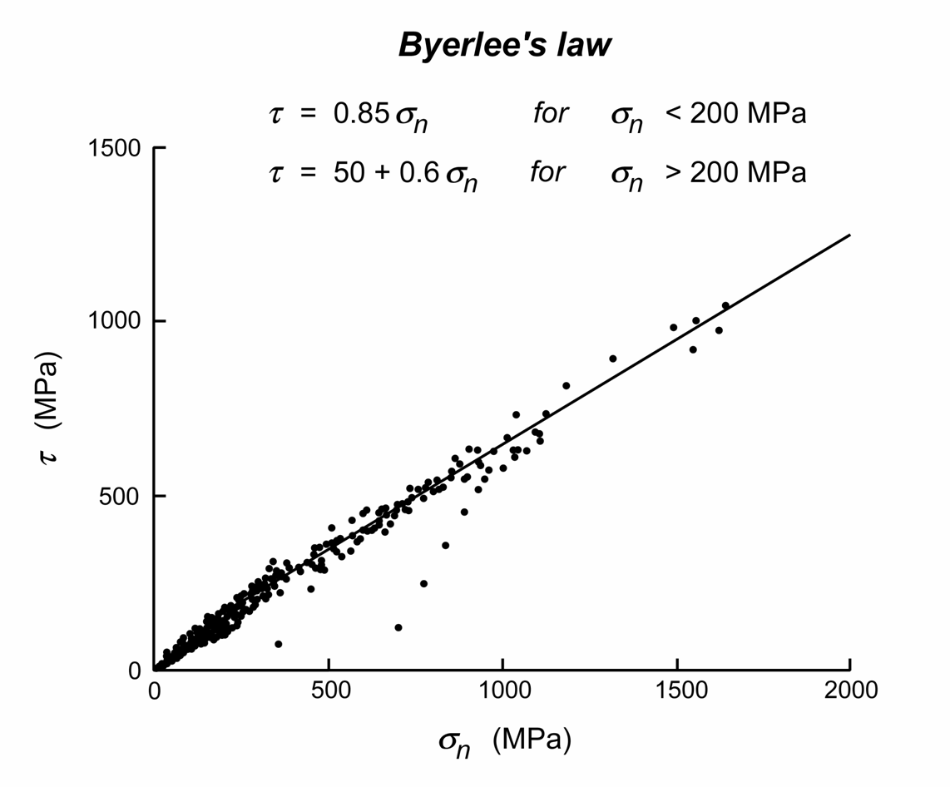
Failure criteria – previously faulted rocks
Natural faulting does not generally take place in “intact” rocks but rather it occurs in rocks that contain pre-existing fractures. In the case of major faults, faulting occurs by reactivating old faults. Faulting, therefore, is a matter of attaining the stresses required for frictional sliding
The failure envelope for frictional sliding has a similar slope (coefficient of internal friction) to that for intact rocks, but the cohesive strength (τ₀) is smaller
Almost all lithologies (except those rich in sheet silicates) have a similar coefficient of frictional sliding
at large stresses, μ ~ 0.6 → ϕ ~ 30°
This is Byerlee’s law
Notes:
Figure (redrawn by Steve Covey-Crump from Byerlee, 1978, Pure and Applied Geophysics 116: 615-626, https://doi.org/10.1007/BF00876528) showing the stresses on the fault plane that are required to produce frictional sliding. The figure incorporates data from a wide range of different lithologies
Byerlee’s law (the equations stated in the figure) is widely used to describe the strength of the upper crust. Conversely, by making the assumption that the crust is on the verge of failure (that is, that the crust is “critically stressed”), Byerlee’s law may be used to estimate the state of stress in the crust. The critically-stressed condition of the crust is discussed by Townend & Zoback, 2000, Geology 28: 399-402, https://doi.org/10.1130/0091-7613(2000)28<399:HFKTCS>2.0.CO;2, and by Zoback & Townend, 2001, Tectonophysics 336: 19-30, https://doi.org/10.1016/S0040-1951(01)00091-9 (see also Class 5 Slide 37)
At σ_{n} = 200 MPa the value of τ given by the two parts of Byerlee’s law is the same: 0.85σ_{n} = 50 + 0.6σ_{n} → 0.25σ_{n} = 50 → σ_{n} = 200
Note that Byerlee’s law is not really a ‘law’ but rather it is an empirical observation

Slide 26
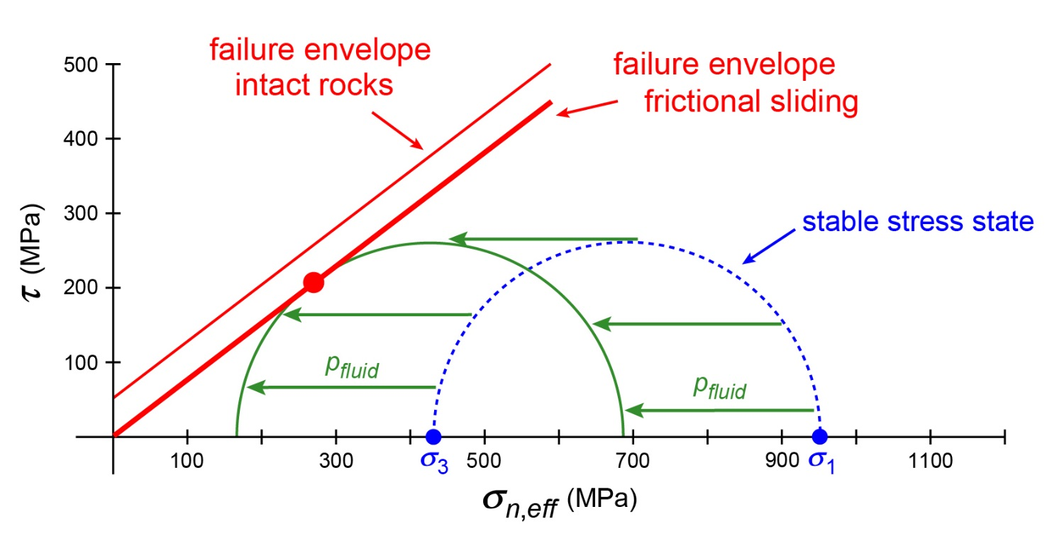
Failure criteria – the effect of pore fluid pressure
Pore fluid pressure promotes brittle failure – on a Mohr diagram, if we increase pore fluid pressure, we shift the Mohr circle describing a stable state of stress (one below the failure envelope) to the left; if the pore fluid pressure is large enough, the failure envelope is intersected and failure occurs
Note that the effect of pore fluids is NOT to lubricate the fault, but rather to jack the fault apart so that there is less normal stress pushing the fault walls together
Notes:
The points made on this slide were noted in the last class (see Class 6 Slide 16). The fact that pore fluid pressure only affects normal stresses not shear stresses (so that the Mohr circle shifts left without changing its diameter) was also noted in Class 5 Slide 16
Figure by Steve Covey-Crump. In the presence of pore fluids, the normal stress (x-axis) becomes the effective normal stress (= normal stress minus pore fluid pressure) – the failure envelope is a relationship between shear stress and effective normal stress at failure (on the previous slides, it is implicitly assumed that the rocks are dry, that is, pore fluid pressure is zero, and so the effective normal stress = the normal stress)

Slide 27
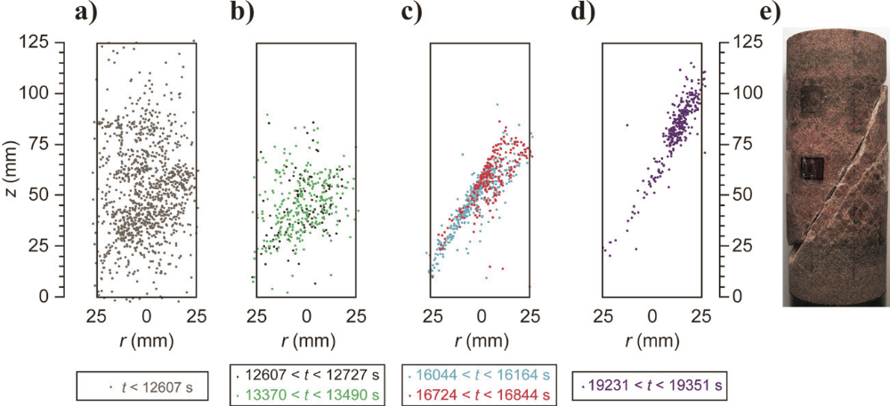
From microcracking to failure
Brittle failure occurs through the formation and coalescence of microcracks; these develop around flaws in the material
The formation of a new crack relieves the local stresses and so the next crack forms elsewhere in the sample
However, stresses are concentrated around crack tips → regions with high crack density (and hence more crack tips) come to be more highly stressed → when there are sufficient cracks to make this effect significant, microfracturing focuses in these regions → coalescence of cracks and localization of the deformation on a through-going fracture
Notes:
Stresses around cracks may be analysed by treating the crack as having an elliptical shape (in 2D). The stresses around elliptical holes (flaws) within an externally loaded plate may be calculated to determine (a) where around the flaw they are at a maximum (this will be the point at which the crack will grow), and (b) at what externally applied load crack propagation will occur. This forms the foundation of one of the most important theories of brittle failure (that of Griffith)
Figure (from Mayr et al., 2011, Geophysics 76(3): MA21-MA32, https://doi.org/10.1190/1.3569579) showing the location of microcrack events at different times in an axially compressed sandstone sample as it was being loaded to failure. The colour coding in the two middle diagrams represents two different sub-intervals of time (black before green, and blue before red)

Slide 28
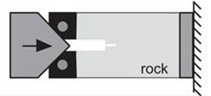
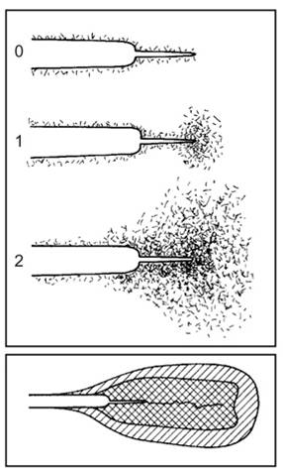
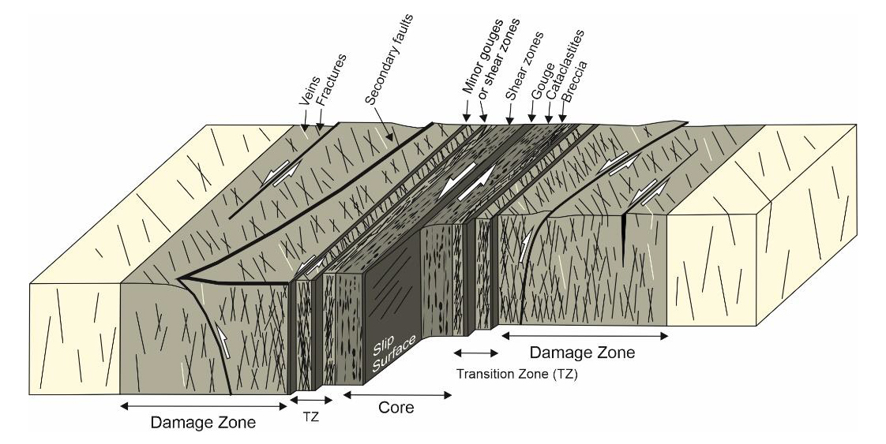
From microcracking to fracture propagation
If a macroscopic fracture already exists, microcracking is focused in the region just ahead of the fracture tip where the stresses are greatest. This complex region of deformation is called the process zone
This concentration of microcracking activity is why most faults have a well-defined core of intense cataclastic deformation and a surrounding damage zone of less intense fracturing
Notes:
Figures right (from Pollard & Fletcher, p.355, but originally from Hoagland et al., 1973, Rock Mechanics 5: 77-106, https://doi.org/10.1007/BF01240160) showing the distribution of flaws around a crack at three moments as it is being prised apart
Figure left from Choi et al., 2016, Earth-Science Reviews 152: 70-87, http://dx.doi.org/10.1016/j.earscirev.2015.11.006

Slide 29
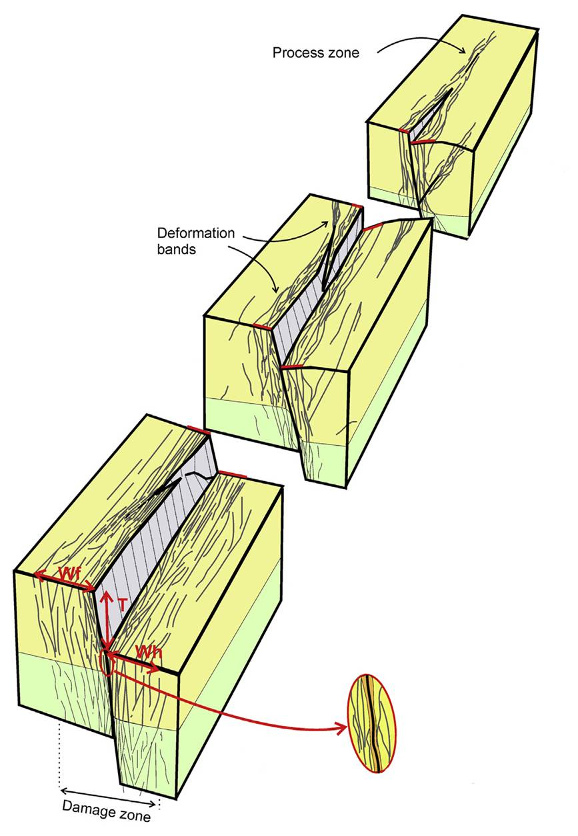


Characterizing fault damage zones
W5min
W5max
Fracture density with distance from the fault core (top), damage zone width as a function of fault throw (bottom)
Notes:
The width of a fault damage zone is commonly defined subjectively – the figures on this slide show one scheme that attempts to be more quantitative. For an attempt to define this width more rigorously, see Choi et al., 2016, Earth-Science Reviews 152: 70-87, http://dx.doi.org/10.1016/j.earscirev.2015.11.006
In the approach illustrated on this slide, simply count fractures at different locations along a line parallel to the dip direction of the fault (in an ideal world, one would count fractures at several locations along a line oriented parallel to the pole of the fault plane). Then in the top right figure on the slide, three different widths are defined (W1, W5, W10): W5 is the average of W5_{min} the distance below which all measurements of the number of fractures per metre are greater than 5 and W5_{max} the distance beyond which all measurements of the number of fractures per metre are less than 5 (likewise for W1 and W10 but with 1 fracture per metre and 10 fractures per metre respectively). The correlation of W5 with fault displacement is shown for many faults in a particular field area in the figure bottom right, Note that in the dataset shown, the damage zone is wider in the hanging wall compared with the footwall (the red data sit higher in the figure than the black data)
For different methods of estimating fracture density (if one felt the need to quantify these), see the notes to Class 6 Slide 25
For a field study focusing on the analysis of fractures within damage zones (the sorts of things you could do in the field), see Mitchell & Faulkner, 2009, Journal of Structural Geology 31: 802-816, https://doi.org/10.1016/j.jsg.2009.05.002. For a more detailed analysis attempting to correlate damage zone width and the spacing of deformation bands within it, with fault displacement (for the case of normal faults in porous rocks), see Schueller et al., 2013, Journal of Structural Geology 52: 148-162, https://doi.org/10.1016/j.jsg.2013.03.013
All the figures come from Schueller et al., 2013, Journal of Structural Geology 52: 148-162, https://doi.org/10.1016/j.jsg.2013.03.013

Slide 30


Dynamic fracturing
When fracture propagation is fast (as in earthquakes), damage around the fault is linked to the transient stress conditions at the fracture tip (dynamic fracturing)
Pervasive fracturing occurs, particularly on the side of the fault where the transient stresses are tensile
t / d ~ 1
Magnitude and orientation of σ₁ at the tip of a shear fracture propagating to the right at 0.9V_{s}
t / d ~ 0.1
Microstructural features that are unique to seismic rates of slip (e.g., friction melts, particular fracture patterns) provide evidence for palaeo-earthquakes
Fault zone thickness is greater at given fault displacement than in fault core-damage zone scenarios
Notes:
Damage that occurs during the transient stress conditions arising during fast fracture propagation is commonly described as ‘coseismic’. These stresses arise because the slip velocity rises from zero behind the tail of the rupture up to a maximum and then back down to zero ahead of the rupture tip, that is, because the slip-rate varies along the rupture. Dynamic fracturing occurs for fault slip rates of > 1 ms⁻¹ (or perhaps even at slip rates > 0.1 mms⁻¹)
During dynamic fracture, loading is so fast that inertial terms need to be included in the equations of motion that are used to determine the deformation response. Theoretically, the terminal velocity of a fast-propagating fracture is the Rayleigh wave velocity (V_{R}). This is about 0.92 × shear wave velocity (V_{s}), or more precisely, V_{R}/V_{s} ~ [0.862 + (1.14ν)] / (1+ν) where ν ~ 0.25 for rocks = Poisson’s ratio
For a review of features that may indicate seismic slip-rates (palaeo-earthquakes) rather than slower slip, see Rowe & Griffith, 2015, Journal of Structural Geology 78: 1-26, https://doi.org/10.1016/j.jsg.2015.06.006. For such features in limestones, see e.g., Delle Piane et al., 2017, Journal of Structural Geology 103: 17-36, https://doi.org/10.1016/j.jsg.2017.09.003; Delle Piane et al., 2018, Geology 46: 163-166, https://doi.org/10.1130/G39584.1. For an analysis of quartz deformation microstructures that was used to infer an interval of coseismic deformation within a period of much slower deformation, see Trepmann & Seybold, 2019, Geoscience Frontiers 10: 43-54, https://doi.org/10.1016/j.gsf.2018.05.002
Figure top right (from Di Toro et al., 2005, Nature 436: 1009-1012, https://doi.org/10.1038/nature03910) showing the calculated maximum principal stress magnitude (colour coding) and orientation (black lines) around a fracture propagating to the right at a speed of 0.9 × shear wave velocity (~0.98 of the Rayleigh wave velocity). Stresses in the top half of the figure are compressive; those in the bottom half are tensile. Since rocks are generally weaker in tension than in compression, fractures will develop preferentially in the tensile areas and have an orientation locally parallel to the black lines. Di Toro et al. observed melt filled fractures (pseudotachylytes) in this orientation around the Gole Larghe Fault in northern Italy
Figure bottom left (from Fondriest et al., 2017, Earth and Planetary Science Letters 461: 8-19, https://doi.org/10.1016/j.epsl.2016.12.024) showing the relationship between fault zone thickness and fault displacement observed for normal/reverse/strike-slip faults (a relationship noted in Class 4 Slide 5) with, in red, observations made on a fault within dolomites in the Foiana Fault Zone, northern Italy. The larger red star shows the thickness/displacement ratio in a region of suspected coseismic damage – note that it lies well above the trend of the other data, that is, at given fault displacement the thickness of the damage zone was much larger

Slide 31


Coalescence of microcracks
A key step in macrofracture formation and propagation is the linking of favourably oriented microcracks
Extension fractures and shear fractures do this differently – extension fractures can propagate in their own plane, but shear fractures cannot and instead link up via extension fractures
Linking of shear fractures by extension fractures (wing cracks)
Notes:
Figure left (from Fossen, p.135) showing, on the left, extension fractures linking up and, on the right, shear fractures (the red lines) linking up
Photo (Pollard & Fletcher, p.369, but originally from Brace & Bombalakis, 1963, Journal of Geophysical Research 68: 3709-3713, https://doi.org/10.1029/JZ068i012p03709): wing cracks developing under compressive loading on the ends of three en échelon shear fractures (in glass). Note how the wing cracks curve into alignment with the loading direction (σ₁)

Slide 32

Linking fractures within an en échelon array
At the exposure scale it is not uncommon to find incipient faults developing through the linking of the components of an en échelon array of extension fractures
Notes:
Photo and figure (from Gudmundsson, p.423): en échelon array of joints forming an incipient fault (parallel to one that has already formed below it) in a bedded chalk succession. Note the combination of photo and line-drawing. An initial line-drawing in your field notebook is a big help, even if the final line-drawing comes from the photo, because you can see more in the field (moving around changes the lighting conditions)

Slide 33



Linking fractures within an en échelon array 2
At this scale, fracture coalescence can be profitably considered in terms of the factors influencing the deflection of fractures at interfaces (see last class)
Notes:
The linking of fractures within a layered sequence is influenced by the variation of rock unit properties, layer thickness, and layer interface properties through the sequence, that is, by the mechanical stratigraphy. For a review of the key concepts of mechanical stratigraphy, see Ferrill et al., 2017, Journal of Structural Geology 94: 275-302, https://doi.org/10.1016/j.jsg.2016.11.010
Photo left (Steve Covey-Crump): an en échelon array of extension fractures – an incipient fault? A later left-right trending dyke crosscuts the en échelon array just above the middle of the photo, Ross of Mull, Scotland
Photo middle (Steve Covey-Crump): an en échelon array of transtensional fractures (dextral sense of shear + simultaneous extension) that are in the process of linking, West Angle Bay, Pembrokeshire
Photo right (from Larsen et al., 2010, Marine and Petroleum Geology 27:1531-1550, https://doi.org/10.1016/j.marpetgeo.2010.03.011): fractures in bedded carbonates that are linked by a fracture running along the contact between the beds, Pizzicoli Quarry, Gargano Promontory, southern Italy

Slide 34
Growth of faults

Slide 35


Fault length frequency
When faults and associated fractures are mapped over a wide range of scales, it is commonly found that plots of cumulative frequency vs. fault trace length show a power law relationship
The relationship appears to break down at small lengths because small fractures are more easily overlooked; it also appears to break down at long lengths when the faults are longer than the map
The slope of the power law relationship decreases with increasing deformation (more long faults) but the significance of the actual value of the slope remains poorly understood
Fault population data for Valles Marineris on Mars. Two sets of data are shown: individual faults (open symbols) and faults that are made up of linked segments (filled symbols)
Notes:
Recall that a power law relationship produces a straight line on a log-log plot: y = Ax^{n} → logy = logA + nlogx
A review of the measurement and significance of power law relationships in fractured systems is given by Bonnet et al., 2001, Reviews of Geophysics 39: 347-383, https://doi.org/10.1029/1999RG000074
Figure top right from Schultz, 2000, Tectonophysics 316: 169-193, https://doi.org/10.1016/S0040-1951(99)00228-0 − note that the straight-line relationship breaks down at small L and at large L
Image bottom (from lasp.colorado.edu/home/mariner9/): Mariner 9 image of Mars with Valles Marineris running across the equatorial regions. This valley system is over 4000 km long, 200 km wide and up to 10 km deep. However, its precise origins remain uncertain (e.g., see Dohm et al., 2009, Journal of Volcanology and Geothermal Research 185: 12-27, https://doi.org/10.1016/j.jvolgeores.2008.11.029)

Slide 36



Displacement variation along a fault
The displacement on a fault cannot be constant over the whole fault surface because it must decrease to zero at the end (tip) of the fault
Displacement variations along or across a fault may occasionally be mapped, but the best datasets come from high quality 3D seismic surveys
Notes:
Figure top left from Twiss & Moores, p.84
Figure bottom left from Fossen, p.188
Photo right (from Fossen, p.207): relay ramp (see Slide 39), Arches National Park, Utah

Slide 37


Displacement variation along a fault 2
Given adequate data, displacement profiles showing displacement vs. distance along a fault, may be constructed. These are classified as peak, bell-shaped, and plateau types
Large faults slip along a limited portion of their surface and so the total displacement is the sum of displacements from many individual events. The shape of the displacement profile therefore depends upon the size and location of the individual events
Hence fault displacement profiles can provide information about the growth history of the fault and the nature of interactions with other faults
Notes:
For an example of the analysis of fault displacement profiles, see Xu et al., 2014, Tectonophysics 636: 190-200, https://doi.org/10.1016/j.tecto.2014.08.023. For a nice analysis where time is added by dating lava flows that have been offset by the faulting, see Iezzi et al., 2020, Journal of Structural Geology 133, article 103976, https://doi.org/10.1016/j.jsg.2020.103976. The latter is a development of work of this kind in the Apennines of central Italy (e.g., Roberts & Michetti, 2004, Journal of Structural Geology 26, 339-376, https://doi.org/10.1016/S0191-8141(03)00103-2) which has ultimately allowed fault slip at the surface in central Italy to be interpreted as the consequence of viscous flow in the deep crust and upper mantle (Cowie et al., 2013, Nature Geoscience 6, 1036-1040, https://doi.org/10.1038/ngeo1991)
Figure bottom left from Fossen, p.204
Figure top right from Fossen (1st edition), p.160

Slide 38

Fault length – displacement relationships
The maximum displacement (D_{max}) on a fault is commonly observed to have a power law relationship with fault length (L)
Notes:
For a review of the fault displacement – length systematics, see Kim & Sanderson, 2005, Earth Science Reviews 68: 317-334, https://doi.org/10.1016/j.earscirev.2004.06.003. Similar displacement – length relationships also apply for extension fractures and deformation bands, see Schultz et al., 2013, Journal of Structural Geology 48: 85-94, https://doi.org/10.1016/j.jsg.2012.12.005. The explanation of why this displacement – length relationship exists remains an area of active research. For recent developments, see Stanton-Yonge et al., 2020, Journal of Structural Geology 133, article 103993, https://doi.org/10.1016/j.jsg.2020.103993
Figure from Burbank & Anderson, 2012, Tectonic Geomorphology (2nd edition), Wiley-Blackwell, p.86. Note the change in scaling relationship at a fault length of ~100 m. The scatter on plots of this kind can be attributed in part to the difficulty in determining where on the fault D_{max} (the maximum height of the displacement profile) should be measured, and also in determining fault length L – if the fault is an elliptical area of slip, the length of the fault on a topographic surface depends upon where that topographic surface cuts the ellipse
For comments on fault displacement – length characteristics in a planetary context, see Schultz et al., 2010, Journal of Structural Geology 32: 855-875, https://doi.org/10.1016/j.jsg.2009.09.005

Slide 39

Fault linking – relay ramps
A
As faults grow, they become more likely to interact with nearby faults. Two faults may join to form a single much longer fault. Growth in this manner gives rise to a number of important structures
B
D
C
E
Notes:
Consider two faults whose tips approach each other. Before the tips reach each other but after their strain fields have started to interfere, they are said to underlap. Once the tips have passed each other, they are said to overlap. The zone of overlapping (relay ramp) becomes deformed as the result of displacement transfer from one fault to the other. Eventually this relay structure fails (breached relay ramp), and the two faults become connected. Typically, there is a fault bend at the connection point
For an example of a study that seeks to use measurements of underlap and overlap to establish criteria for whether or not fractures will link in this way, see Lamarche et al., 2018, Journal of Structural Geology 108: 171-179, https://doi.org/10.1016/j.jsg.2017.11.016. Linking of fractures is significant because fracture connectivity controls rock permeability
Photos (from Fossen, p.206): faults induced by splashing water on to the beach sand of a lake in Colorado

Slide 40




Fault linking – relay ramps 2
Relay ramps intact (above) and during breaching (right)
Notes:
Photos (Steve Covey-Crump): relay ramps on the collapsing road surface at Mam Tor landslip in 2012

Slide 41


Fault linking – relay ramps 3
(Above) relay ramps on the Moon along Rupes Recta
(Right) The fault displacement profile
Notes:
Rupes Recta is a normal fault in the eastern part of Mare Nubium. It is made up of several en échelon segments (separated by relay ramps), making a total length of ~110 km. The geometry and possible formation of the fault is described by Nahm & Schultz, 2015, Geological Society, London, Special Publications 401: 377-394, https://doi.org/10.1144/SP401.4
Photo left (from Shirao & Wood, 2011, The Kaguya Lunar Atlas, https://doi.org/10.1007/978-1-4419-7285-9)
Figure right (from Nahm & Schultz, 2015, Geological Society, London, Special Publications 401, 377-394, https://doi.org/10.1144/SP401.4)

Slide 42


Transfer zones
The structures that form in the zone of overlapping between two faults (transfer zone) depend upon whether the deformation there is extensional (releasing overlap zones) or contractional (restraining overlap zones)
Extensional fracture transfer zone
Notes:
Figures left (from Twiss and Moores, p.87): note that in the extensional case, the two middle lazy arrows of the four are directed away from each other, whereas in the contractional case, they are directed towards each other – let your intuitions do the rest of the thinking
Photo (Fossen, one of the extra figures on the web-site for the book, folk.uib.no/nglhe/StructuralGeoBook.html): Mosaic Canyon, Death Valley, California. The sense of movement indicated by the lazy arrows follows from the presence of extensional fractures (veins) within the transfer zone. Note the drag folding just below the middle of the photo which supports the sense of movement indicated by the lazy arrows

Slide 43


Further examples of extensional transfer zones
Notes:
Photo top (Steve Covey-Crump): La Dalle à Ammonites des Isnards, Digne-les-Bains, SE France. The sense of movement indicated by the lazy arrows follows from the presence of extensional fractures within the transfer zone
Photo bottom (Steve Covey-Crump): veins at Kentallen Pier, Scotland. Again, the sense of movement indicated by the lazy arrows follows from the presence of extensional fractures (veins) within the transfer zone. Those of you going on the Easter field course to Scotland will visit this locality, although I don’t always manage to find the spot where I took this picture. The ovoids in the host rock are weathered-out cordierite porphyroblasts (the locality is in the metamorphic aureole around the Ballachulish plutonic complex)

Slide 44

Fault bends (changes in strike)
Bends and jogs in faults in map view are common and result from fault segments that have linked via the creation and breaching of relay ramps
Bend in a normal fault, Krafla Fissure Swarm, North Iceland
Notes:
Photo from Gudmundsson, p.430

Slide 45


Fault bends (changes in dip)
Similar features may also be found with depth – linking of en échelon fractures to produce a fault that steepens with depth may result in dilation during slip
If pore fluids are present, this leads to decompression and precipitation
If fault slip is fast, the decompression may be explosive, leading to brecciation
Notes:
Figure left from Ramsay & Huber, p.518
Figure right (from Kokelaar & Moore, 2006, Classical Areas of British Geology: Glencoe Caldera Volcano, Scotland, British Geological Survey, p.96) shows a model for the formation of the pseudotachylytes on the ring fault that runs around the Glen Coe caldera (those going on the Easter field course to Scotland will do an exercise inside the Glen Coe caldera, although you probably won’t visit the ring fault). The incipient caldera fault, with a bend, intersected a hydrothermal system at several hundred metres depth. Rapid collapse on the fault led to a correspondingly rapid dilation at the fault bend. This caused the hydrothermal system to explode. Decompressed and fragmented frictional melts formed during the fault slip were then blasted upwards into the cavity, plastering its sides, and lithic breccias were swept up-conduit. Fragmented rhyolitic magma then invaded the fault cavity, and then magma from depth arrived (the latter forms the Glen Coe Ring Fault intrusion)

Slide 46



Fault segmentation
Notes:
Two photos at top (Steve Covey-Crump): the road surface on the Mam Tor landslip (in 2012), showing the development of fault bends by the linking of fault segments
Photo bottom (Steve Covey-Crump): segmented fracture in the road surface, Senez, France

Slide 47


Fault segmentation 2
Notes:
The curved geometry of the Wasatch fault zone (Utah) suggests a history of fault segment linking
Figure left from Burbank & Anderson, 2012, Tectonic Geomorphology (2nd edition), Wiley-Blackwell, p.91
Figure right from Fossen, p.208. The sketches show the various stages of an experiment in which a plaster slab was stretched

Slide 48

When faults end
The end of a fault (where the discontinuity in displacement goes to zero) is the tip-line. A tip-line must form a closed loop – it cannot simply end. For faults that break the surface (faults that do not are described as blind faults), the tip-line connects the ends of the trace of the fault in a line that loops around below the surface
The only variant on this geometrical necessity occurs if a fault ends by joining another fault of the same type. The line of intersection between two faults is then described as a branch-line
In some cases, a fault block is completely surrounded by faults and is then described as a horse
A full understanding of these geometric aspects is critical when mapping faulted terranes if a restorable cross-section is to be constructed
Notes:
In the remaining classes we will attempt to make sense of these remarks since they go to the heart of the task of creating a self-consistent structural interpretation
A restorable cross-section is one that can be undeformed to reproduce the original stratigraphy before deformation. A section that does not restore is one that leaves gaps or locates two bits of section in the same space when one attempts to reverse the deformation – such a cross-section is WRONG unless it arises from something ignored in the method used to restore the section
Figure from Twiss & Moores, p.85

Slide 49

When faults end 2
Faults of all types commonly die out in a set of splay faults – smaller, subsidiary faults that branch off from the main fault. If these branch off at regular intervals and have similar geometries, they form an imbricate fan
Imbricate fans may be extensional or contractional
We will consider these within different tectonic contexts over the final three classes, as we examine the interrelationships of structures in contractional, extensional and strike-slip terranes
extensional
contractional
Notes:
Figure from Twiss & Moores, p.85

Slide 50

Summary of fault and fracture terms
For a glossary of fault and fracture terms, see Peacock et al., 2016, Journal of Structural Geology 92: 12-29
Notes:
Figure from Peacock et al., 2016, Journal of Structural Geology 92: 12-29, https://doi.org/10.1016/j.jsg.2016.09.008

Slide 51

Reading
Fossen H (2016) Structural Geology (2nd edition). Cambridge University Press. [Chapter 9]
Twiss RJ, Moores EM (2007) Structural Geology (2nd edition). WH Freeman and Co. [Chapter 3]
Gudmundsson A (2011) Rock Fractures in Geological Processes. Cambridge University Press. [Chapters 10, 12, 14]
Price NJ, Cosgrove JW (1990) Analysis of Geological Structures. Cambridge University Press. [Chapter 5]
Ramsay JG, Huber MI (1987) Techniques of Modern Structural Geology. Volume 2: Folds and Fractures. Academic Press. [Session 23]
Pollard DD, Fletcher RC (2005) Fundamentals of Structural Geology. Cambridge University Press. [Chapter 9]

